Slide 1

Employee Transfer Management
Group 4 – C1212L
Group Member:
Duong Hoang Minh (Leader)
Luu Nguyen Van
Hoang Vu
Huy Nguyen Van
Instructor:
Mr. Cuong Nguyen Hung

Slide 2

Problem Definition
Manage huge data
No formal format for transfer records
Maintain
Report

Slide 3
Functional Requirements
Login
Transfer Management
Search
Update
Make new transfer
Employee can request transfer
Approval for request transfer
Generate allowances
Generate report
Logout

Slide 4

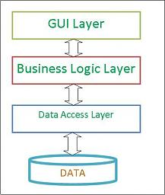
Technology

Slide 5
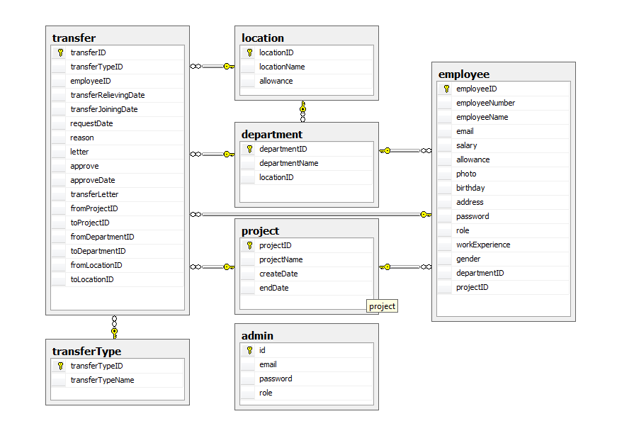
Database

Slide 6
System Requirement

Slide 7
Demo

Slide 8
Acknowledgement

